Slide 1
Boolean Algebra

Slide 2
What is Boolean Algebra
We have only two possible values: 1 or 0 ( true of false)
All operations with Boolean values results in Boolean values: 0 or 1.

Slide 3
Boolean Arithmetic
The laws of real number algebra won't apply here
For instance,
0 + 0 = 0 ( we know that)
0 + 1 = 1 ( we know that)
1 + 0 = 1 ( we know that)
1 + 1 = 1 ( what ?, is that a typo ? )
0 + 1 + 1 = 1 ( no matter how many 1s you add, it is always 1 )
1 + 1 + 1 = 1
1 + 1 + 1 + 0 = 1
1 + 1 + 1 + 1 = 1

Slide 4
Addition – Similar to OR truth table
This resembles our OR truth table we learnt in Propositional Logic
BOOLEAN ALGEBRA of Addition
1 | 1 | 1
1 | 0 | 1
0 | 1 | 1
0 | 0 | 0
TRUTH TABLE FOR OR
T | T | T
T | F | T
F | T | T
F | F | F

Slide 5
Multiplication AND similar to AND
MULTIPLICATION IN BOOLEAN ALGEBRA
1 | 1 | 1
1 | 0 | 0
0 | 1 | 0
0 | 0 | 0
TRUTH TABLE FOR AND
T | T | T
T | F | F
F | T | F
F | F | F

Slide 6
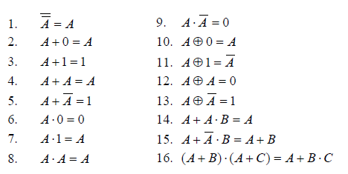
Laws of Boolean Algebra

Slide 7
Boolean Algebra – No subtraction and division
But we have negation. We represent it with a bar on top
negation of 1, represented as Ī = 0 and
negation of 0, represented as Ō = 1
Negation IN BOOLEAN ALGEBRA
T | F
F | T

Slide 8
Variables and Laws of Boolean Algebra
A variable is declared in UPPER CASE
Say A, B or C
The values they might take is: 0 or 1

Slide 9
Identity Laws of Boolean Algebra: Addition
A + 0 = A ( for ex,
if A = 1, then A + 0 becomes 1 + 0 = 1 = A )
if A = 0, then A + 0 becomes 0 + 0 = 0 = A )
A | 0 | A + 0 = A
1 | 0 | 1
0 | 0 | 0

Slide 10
Identity Laws of Boolean Algebra: Addition
A + 1 = 1 ( no matter what the value of A is, A + 1 is 1 ).
A | 1 | A + 1 = 1
1 | 1 | 1
0 | 1 | 1

Slide 11
Identity laws : Addition
A + A = A ( adding A to itself is A, not 2A).
A + Ā = 1
A | Ā | A + Ā
1 | 0 | 1
0 | 1 | 1

Slide 12
Identify Laws : Multiplication
A 0 = 0
A | 0 | A * 0 = 0
1 | 0 | 0
0 | 0 | 0
A 1 = A
A | 1 | A * 1 = A
1 | 1 | 1
0 | 1 | 0

Slide 13
Identify Laws : Multiplication
A A = A
A | A | A * A = A
1 | 1 | 1
0 | 0 | 0
A Ā = 0
A | Ā | A * Ā = 0
1 | 0 | 0
0 | 1 | 0

Slide 14
Laws of Boolean Algebra

Slide 15
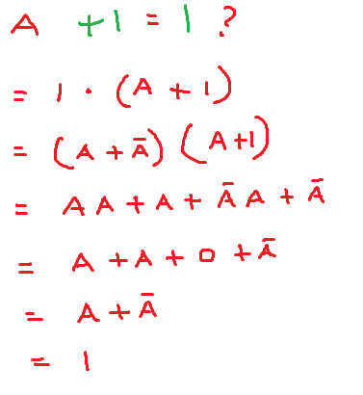
Proving Identify law

Slide 16
Complement of A is unique
That is there are no two Boolean variables.
Prove by contradiction
Assume Ā and ā are two complements of A
We know Ā + A = 1 and A + ā = 1
Ā + A = A + ā
Ā = ā
We have a contradiction. So the complement of A is unique.

Slide 17
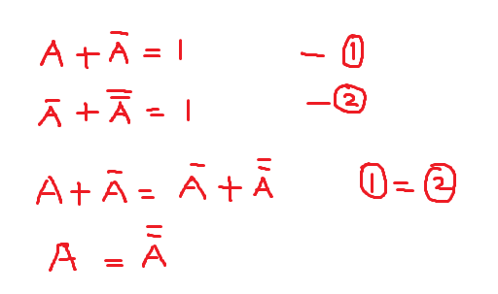
Complement of Ā is A itself

Slide 18
Laws of Boolean Algebra

Slide 19
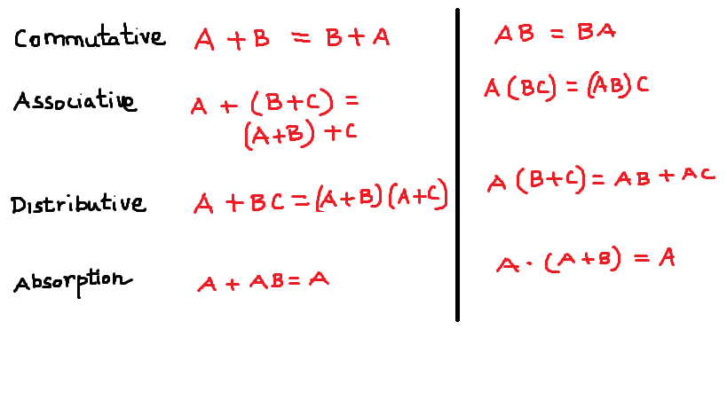

Slide 20
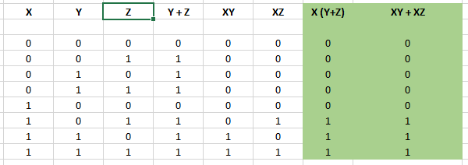
Proving Distributive laws using Table

Slide 21
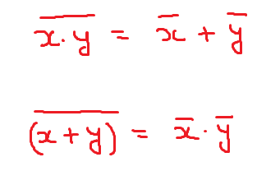
De Morgan's Law

Slide 22
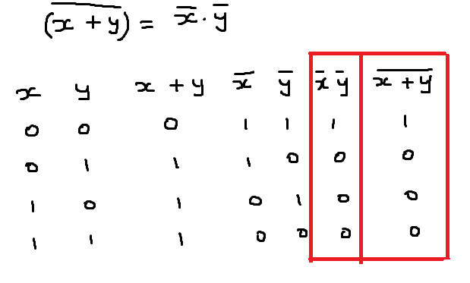
Prove: De Morgan's Law

Slide 23
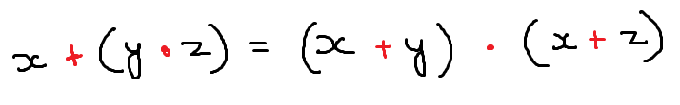
Prove distributive laws using table

Slide 24
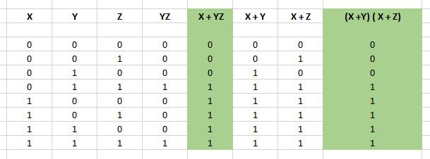

Slide 25
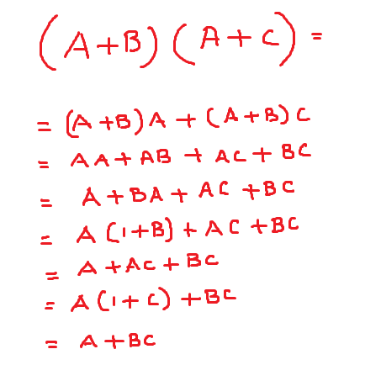
Proving the distributive law (A + B ) ( A + C)

Slide 26
Prove A + A = A
= ( A + A ) 1
= ( A + A ) ( A + Ā ) ( Identify laws)
= A + AĀ ( using distributive law)
= A

Slide 27
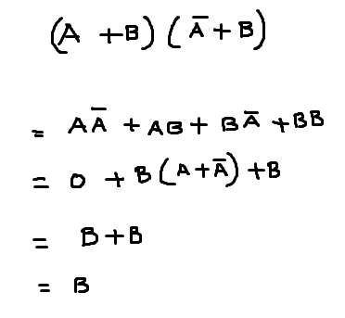
Problem

Slide 28
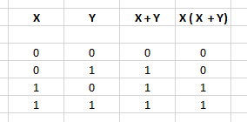
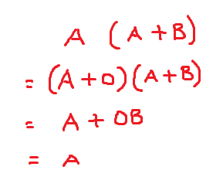
Problem
What is A ( A + B )

Slide 29
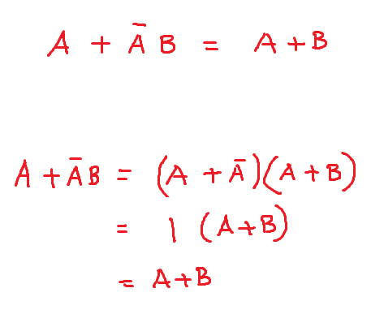
Problem

Slide 30
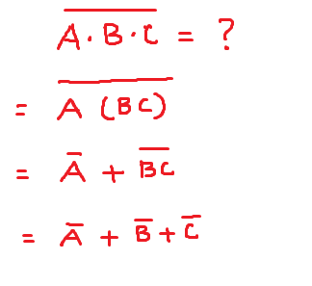
Problem

Slide 31
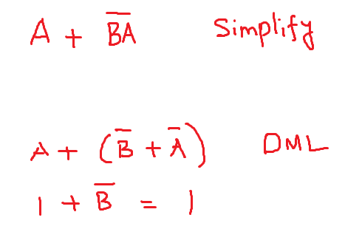
Problem

Slide 32
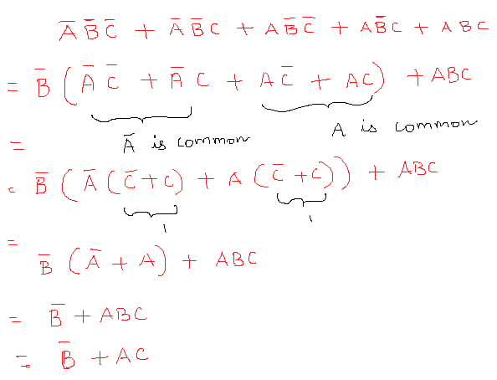
Problem – version 1

Slide 33
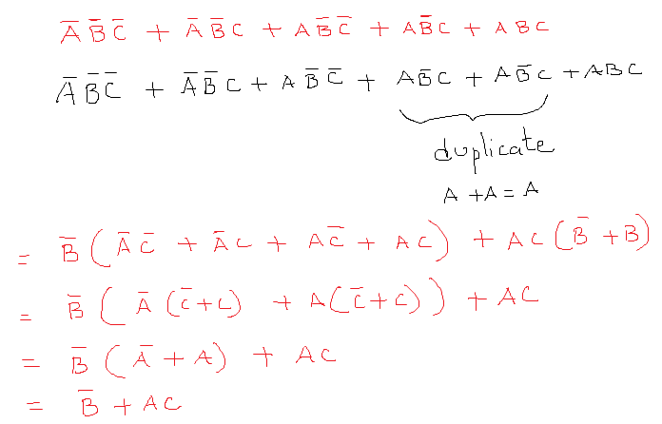
Problem – version 2

